Slide 1
INFO@AFDSNY.ORG
800-520-9594

Slide 2
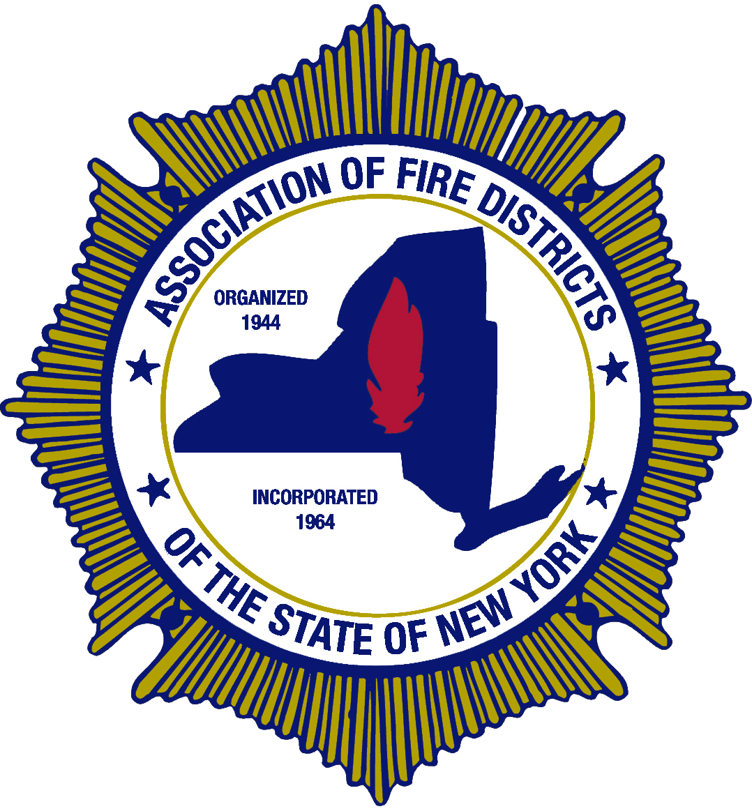
Coffee With Commissioners
Association of Fire Districts
Of the
State of New York
info@afdsny.org 800-520-9594

Slide 3
Today’s Panel
Joe Frank – Assocation Counsel
Dave Denniston – Region 4 Director AFDSNY
Tom Rinaldi – Immediate Past President
Steve Shahan – Attorney – Tully Fire District

Slide 4
Legislative Updates
New York State’s Recently Enacted Cannabis Regulations
About 15 states have or are in the process of legalizing recreational marijuana and 47 out of 50 states allow for some form of medical marijuana.
Just realize the name of the law is, “The Cannabis Regulation and Tax Act”
Two main issues; regulation and taxation
One of the reasons it was included in the Budget Bill
Legalized Use becomes effective immediately

Slide 5
What is Legal?
Legalized use of marijuana for adults over the age of 21
Generally, legalization means a policy that supports a legally controlled market for marijuana, where consumers can buy marijuana for personal use from a safe legal source.
Legalizes the personal possession of up to 3oz of cannabis flower and/or up to 24 grams of concentrates of those ages 21 and older.
Under the law, the smell of marijuana alone is no longer probable cause for a search by law enforcement. Use of cannabis in public may be subject to civil penalties.

Slide 6
Penalties
Possession of marijuana in excess of 3 ounces is a class A misdemeanor and is punishable by no more than 1 year of imprisonment and a fine not to exceed $1,000. Possession of marijuana in excess of 8 ounces – 16 ounces is a class E felony and is punishable by no more than 4 years of imprisonment and a fine not to exceed $5,000. Possession of marijuana in excess of 16 ounces – 10 pounds is a class D felony and is punishable by no more than 7 years of imprisonment and a fine not to exceed $5,000. Possession of marijuana in excess of 10 pounds is a class C felony and is punishable by no more than 15 years of imprisonment and a fine not to exceed $15,000.
Public consumption of marijuana through smoking or vaping will be handled as a violation of New York’s tobacco control laws.

Slide 7
Employee Rights
Many, employers in New York State are now prohibited from taking adverse action or otherwise discriminating against applicants and employees based on their lawful recreational marijuana use.
Most notably for employers, the MRTA amends NYS Labor Law Section 201-d, often referred to as the legal activities law, to prohibit an employer from refusing to hire, employ, or license; to discharge from employment; or otherwise discriminate against an individual because he/she uses cannabis lawfully outside of work hours, off the employer’s premises and without use of the employer’s equipment or other property.

Slide 8
Employer Responsibilities
With that said, amended Section 201-d provides that an employer would not be in violation of the law where it takes action against an employee related to the use of cannabis-based on the following:
The employer’s actions were required by state or federal statute, regulation, ordinance, or other state or federal government mandate;
the employee is impaired by the use of cannabis, meaning the employee manifests specific articulable (capable of being expressed or justified) symptoms while working that decrease or lessen the employee’s performance of the duties or tasks of the employee’s job position, or such specific articulable symptoms interfere with an employer’s obligation to provide a safe and healthy workplace, free from recognized hazards, as required by state and federal occupational safety and health law; or
the employer’s actions would require such employer to commit any act that would cause the employer to be in violation of federal law or would result in the loss of a federal contract or federal funding.

Slide 9
Policies Become Key
It is clear that in light of the amendments to Section 201-d, employers should review their existing drug testing policies to ensure they are not discriminating against individuals for their lawful recreational marijuana use. Employers should also determine if they will continue to drug test individuals for marijuana, and if so, under what circumstances.

Slide 10
Questions To Ask
Do you have a policy and what does your policy cover?
“Zero Tolerance” policies
Reason Suspicion
Random Testing
THC levels compared to impairment levels

Slide 11
What Does This Mean for Fire Service?
Policy is the cornerstone of guiding behavior and having a good policy related to the use of marijuana in all of its forms will help an organization navigate the minefield of the permitted and non-permitted use of marijuana for members of your organization.
Urine tests are accurate so long as labs exercise proper care in sampling.
Blood tests are most accurate.
Hair testing is not the most accurate.

Slide 12
Questions?
Visit www.afdsny.org
Or email us at info@afdsny.org
Or Call Us: 800-520-9594
Have questions or want more information?

Slide 13
INFO@AFDSNY.ORG
800-520-9594

