Slide 1
January 18, 2024

Slide 2
Coffee With Commissioners
Association of Fire Districts
Of the
State of New York
info@afdsny.org 800-520-9594

Slide 3
Today’s Panel:
Jill Holland
Rudy Sunderman
Joe Frank

Slide 4
SFY2023-2024 Volunteer Fire Infrastructure & Response Equipment (V-FIRE)Grant Program

Slide 5
What is the V-Fire Grant
In May of 2023, New York State Governor Kathy Hochul, through her initiatives outlined in the FY2024 State Budget, has devoted $25,000,000 in State funding to support volunteer fire departments. To fortify these efforts, the SFY2023-2024 Volunteer Fire Infrastructure & Response Equipment (V-FIRE) Grant Program has been issued by the New York State Division of Homeland Security and Emergency Services (DHSES) to enhance the security and safety of the citizens of New York State by providing critical funding to strengthen volunteer fire departments and districts.

Slide 6
Funding
$25 Million Budgeted: Can request up to 1 million dollars
Funding Options:
Funding Option 1: Construction/Renovation/Facility Purchase Projects:
A total of $20,000,000 in program funds will be devoted to support Construction/Renovation/Facility Purchase projects and is available to all eligible applicants. The funding amount per application may not exceed $1,000,000 in projects requested under Funding Option 1.
Funding Option 2: Equipment Projects:
A total of $5,000,000 in program funds will be devoted to support allowable fire service equipment projects and is available to all eligible applicants. The funding amount per application may not exceed $500,000 in projects requested under Funding Option 2.

Slide 7
Should an eligible applicant submit for multiple projects within an application under one of the above funding options, they are highly encouraged to prioritize their projects with the most pressing needs and most significant capability gaps. DHSES reserves the right to adjust the allocation caps for either track of funding to support the most critical needs of the fire service community based on the number and type of applications received.

Slide 8
Eligible Organizations Include:
Volunteer Fire Companies that are comprised of 100% volunteer firefighters, that are responsible for providing fire protection services to one or more jurisdiction(s). These entities are required to submit the signed contract agreement with the town or village they are covering.
Nonprofit Fire Companies are eligible to apply and are subject to Prequalification or Prequalification Exempt status as identified below.
• Municipalities – Villages, Towns, Cities and Fire Districts responsible for providing fire protection through a fire department comprised of 100% volunteer firefighter membership.
• Counties and Municipal Shared Services Applications: Counties may only apply on behalf of local volunteer fire departments that are comprised of 100% volunteer firefighter membership, provided the applying county has a minimum of 60% documented approval from the volunteer fire departments within the county that will directly benefit from the requested project(s). Requests for grant funds under a county application must be for shareable projects that will benefit and be accessible to the volunteer fire departments represented in the application. The applying County must complete and submit the Local Volunteer Fire Department Consent Form (Exhibit C), to include at least 60% sign-off from the fire chiefs of agencies represented in the application.

Slide 9
Two or more municipalities may apply for shared projects that will benefit and be accessible to two or more volunteer fire departments. Examples of shareable projects include, but are not limited to, the following:
Fire Training Center, training tower or other training facility
Decontamination or gear-washing trailer
SCBA fill station

Slide 10
SFY2023-2024 Volunteer Fire Infrastructure & Response Equipment Grant Program Objectives
1. Ensure that Fire Stations and Fire Training Facilities within New York State are safe,
structurally sound, meet current building codes and regulations, and support or promote
effective and safe firefighting practices.
2. Support volunteer firefighter safety and health and wellness by providing adequate and up- to-date equipment to include personal protective equipment (PPE), decontamination
equipment and supplies, and effective exhaust removal systems.
3. Support the consolidation of fire service resources through regionalization efforts to
expand above and beyond jurisdictional boundaries to further enhance local, county and
statewide response efforts.

Slide 11
Timeline
Deadline:
DHSES must receive completed grant applications by April 30, 2024, by 5:00 p.m.
All written questions must be submitted to DHSES by April 23, 2024, by 12:00 noon to ensure that a timely response is provided to the applicant.

Slide 12
Standard Cost Reimbursement Contract
Each successful applicant must enter into a standard cost reimbursement contract with DHSES. Such contract will include this Request for Applications, the successful applicant’s proposal, any attachments or exhibits and the standard clauses required by the NYS Attorney General for all State contracts (available upon request). The contract will be subject to approval by the Attorney General and State Comptroller.
https://www.dhses.ny.gov/grant-reporting-forms

Slide 13
Procurements
Applicants must follow and comply with all procurement procedures under General Municipal Law 5A and/or any other state regulations applicable to these funds and will be subject to monitoring by DHSES to ensure compliance.

Slide 14
Social Vulnerability Index (SVI)
CDC/ATSDR Social Vulnerability Index:
Social vulnerability refers to the potential negative effects on communities caused by external stresses on human health. Such stresses include natural or human-caused disasters, or disease outbreaks. Reducing social vulnerability can decrease both human suffering and economic loss.
https://www.atsdr.cdc.gov/placeandhealth/svi/interactive_map.html
Will be determined by the review panel for scoring

Slide 15
Application Evaluation Criteria
Tier 1:
Was the application submitted on time?
Was the application submitted via E-Grants?
Was the application complete, including the required Application Worksheet? The required Application Worksheet must be attached in E-Grants by the submission due date.
Did the application meet all minimum eligibility requirements?
Tier 2:
Point system-Refer to page 13 in the RFA

Slide 16
Questions & Comments

Slide 17
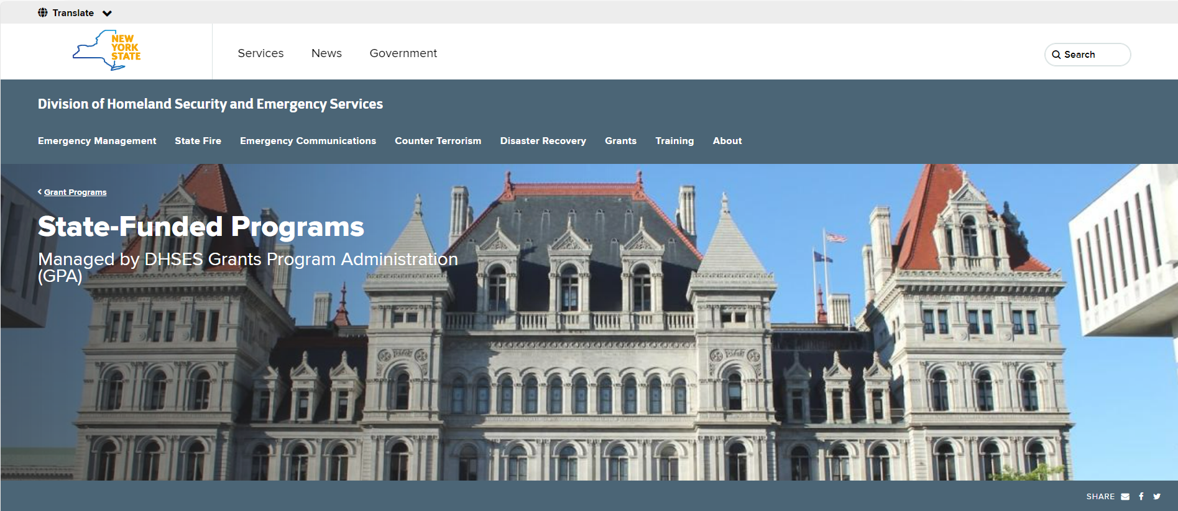
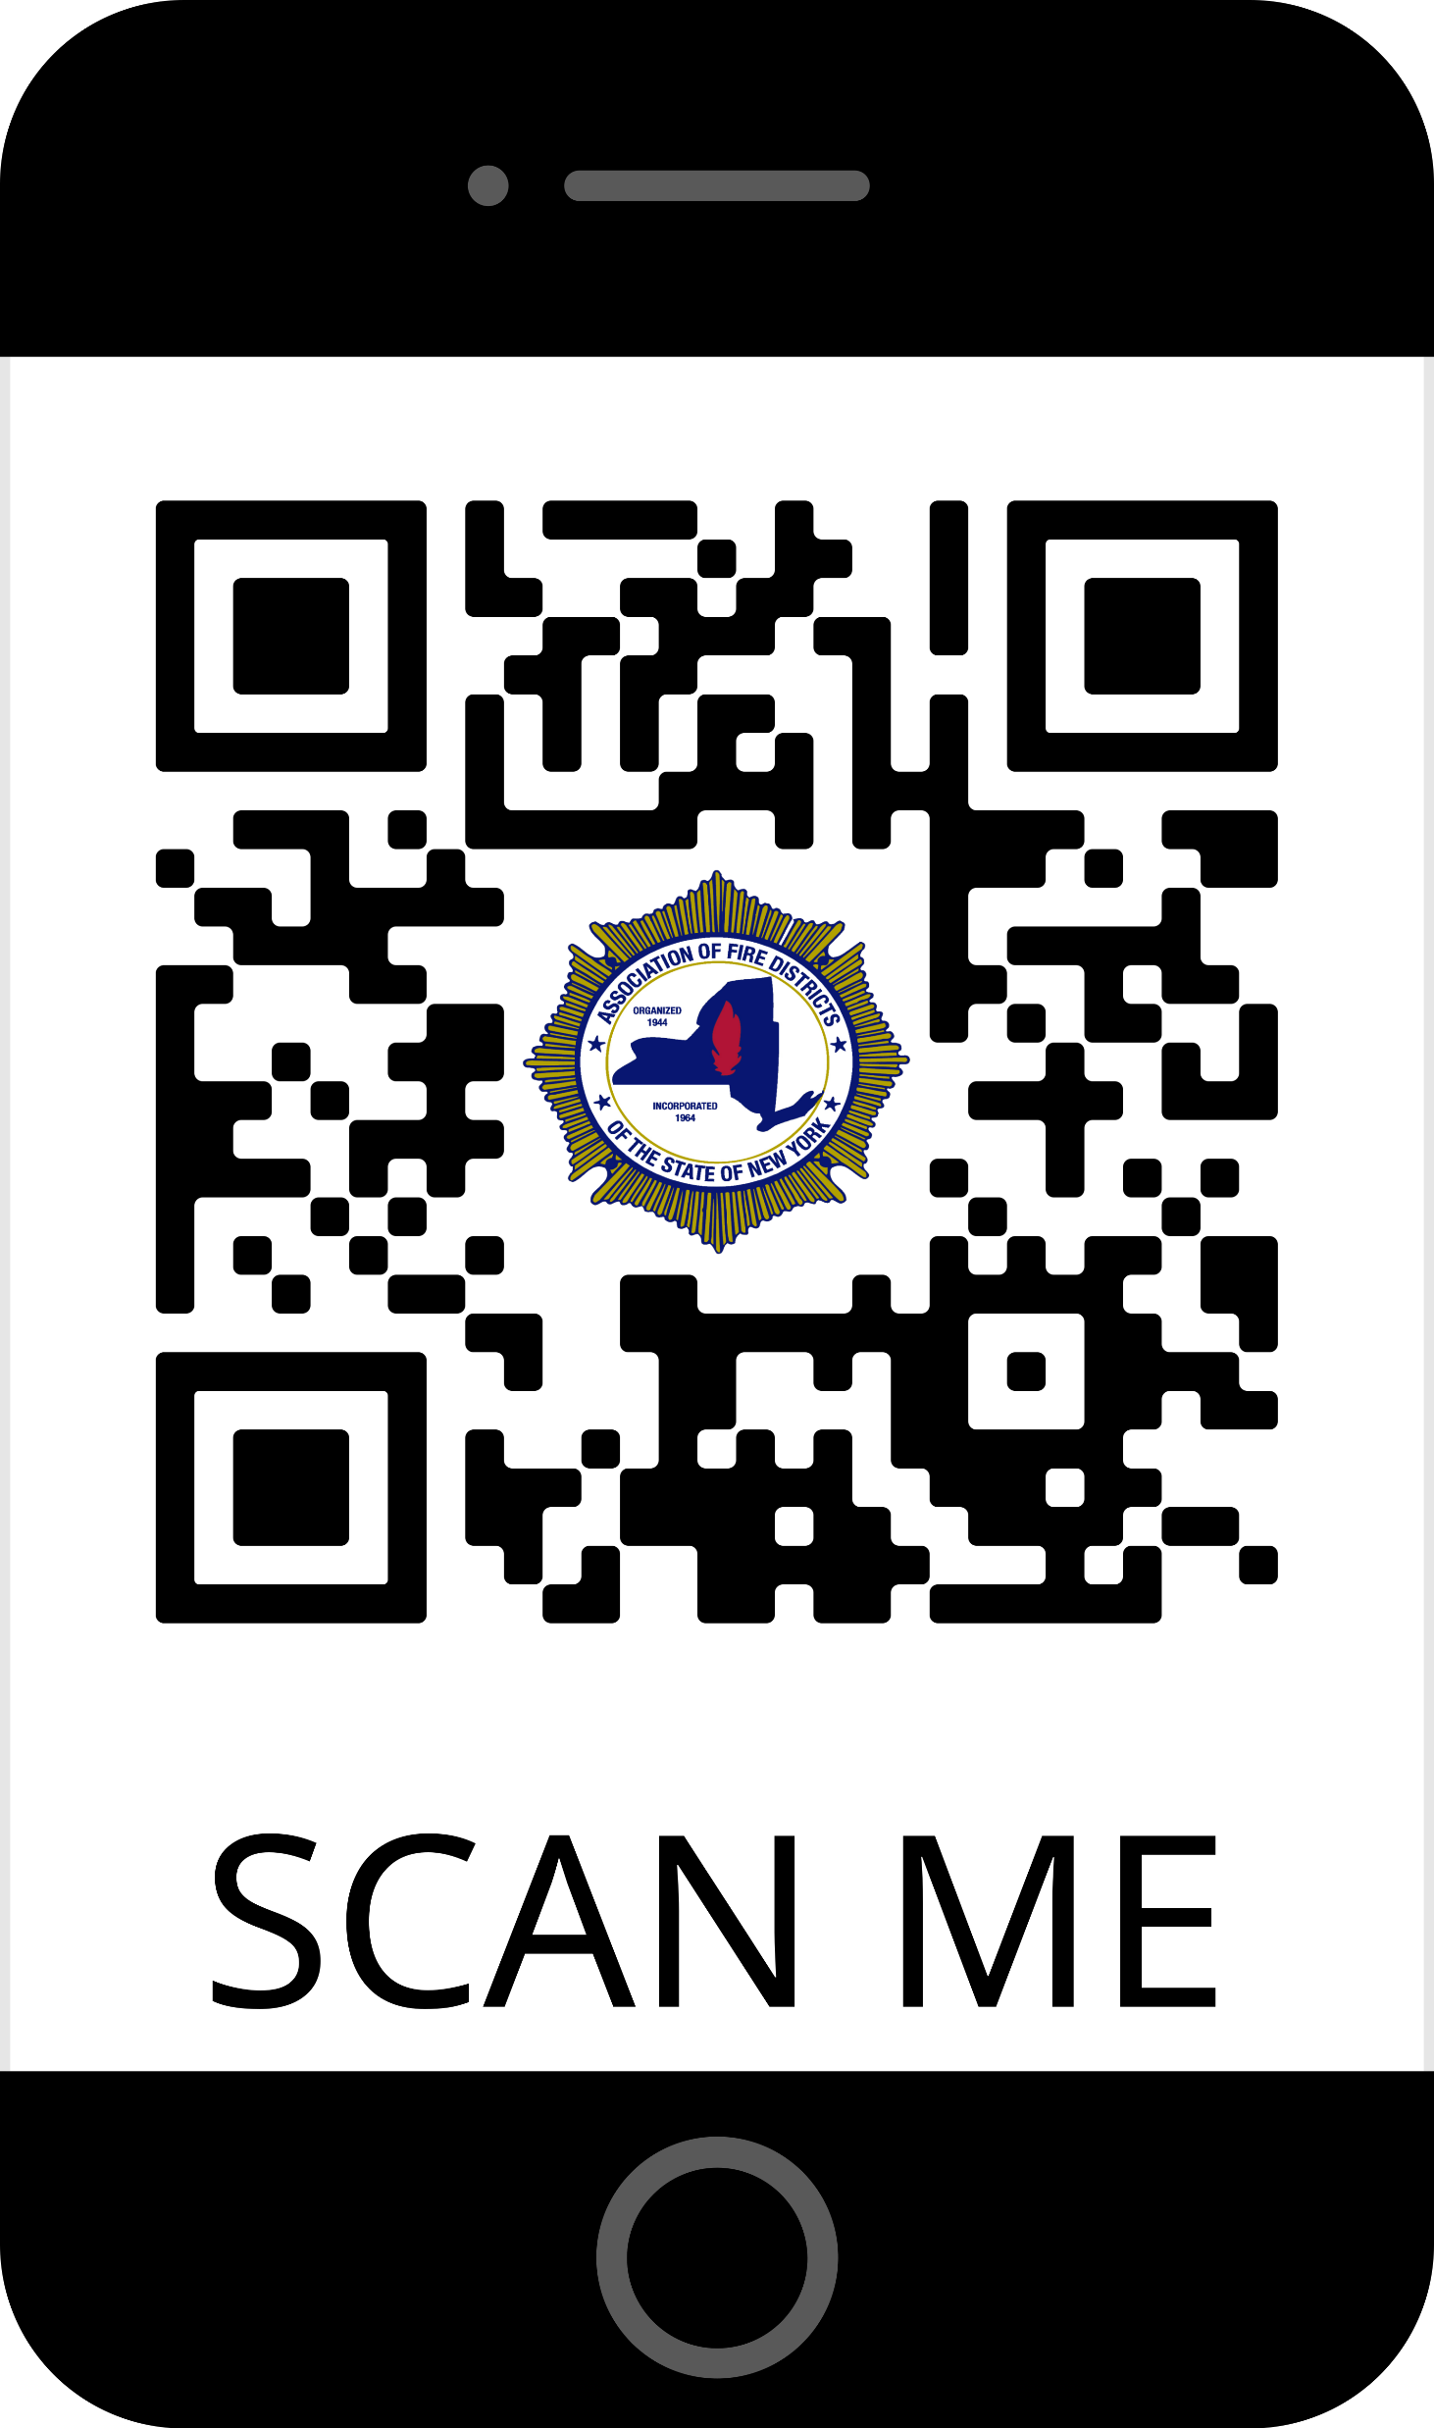
Information can be found at:
Visit this website by scanning the QR Code!
Questions about the grant: Grant.Info@dhses.ny.gov
A recording of this webinar will be posted on the AFDSNY website
https://www.dhses.ny.gov/state-funded-programs

Slide 18
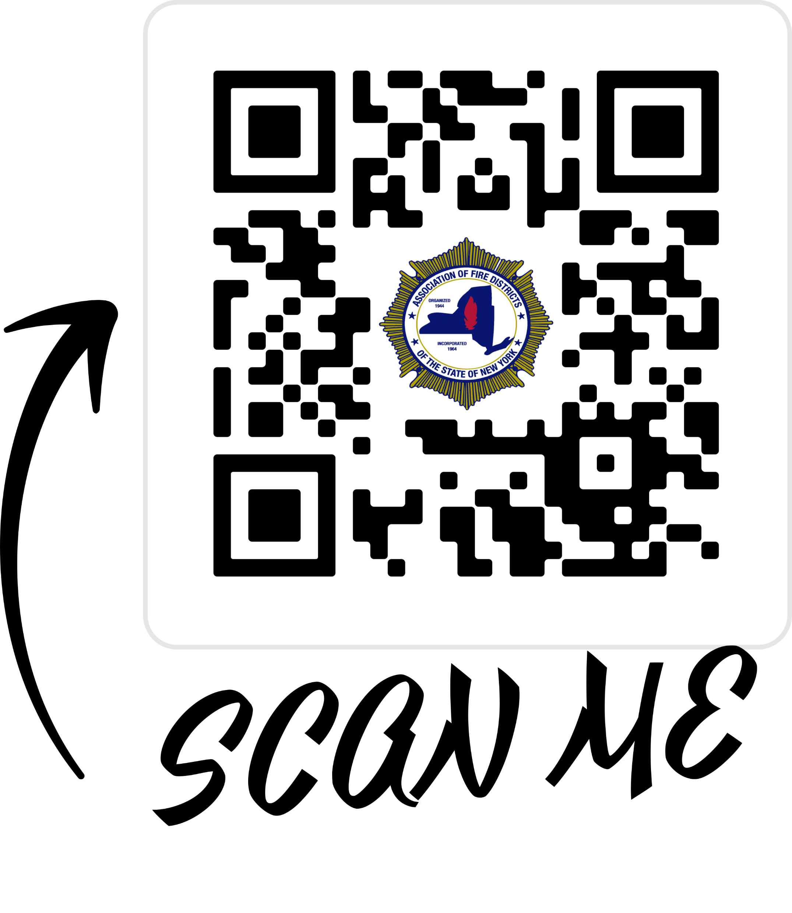
Scan Here for a copy of the Request for Applications
Copies of this document, the FAQ’s as well as the Fire Application Worksheet will be emailed out to all participants following this webinar!
Please watch for our email!

Slide 19
Upcoming AFDSNY Events:
In-Person Commissioner : See website for details/dates
Regional Trainings upon request
AFDSNY Mini Summit: April 26 & 27th Sonesta White Plains Downtown
Mini Summit Western, NY- Details coming soon.
Save the Date! Annual Meeting
October 20 - 23, 2024 Turning Stone Resort & Casino Details coming soon

